Slide 1
Campus printers
Jaden Long

Slide 2

Have you ever had the frustration of ...
Trying to print out a paper for your next class that starts in 5 minutes in the learning center, but the printers there are queued up with 20 other documents (most of them are Lyons’ lecture notes)

Slide 3

Have you ever had the frustration of ...
Sitting in the chemistry classroom, having your lab report ready to print on your computer, only to find that you need a school Chromebook to print (and then your Chromebook just won’t turn on)

Slide 4
Current restriction on printers:
The majority of the students only have access to a tiny percentage of all the printers (more than 40) around campus, through Google Cloud Print:
  2 printers at learning center
  2 printers at writing center
  1 printer in Mr.Shumate’s classroom
  1 printer in middle school
  1 printer in each dorm

Slide 5
More frustration!
Everyone wants to use these printers!
These printers print rather slowly!
They are not in your classroom, so you have to sprint downstairs and back! Wastes time!
It sometimes takes a couple dozen seconds for Google Cloud Print to process, so you don’t know if you successfully printed or not!
The dorm printers never seem to work!
Students can queue a print to a jammed printer, and finding out it doesn’t work, they try to print to another one. When another person fixes the jammed printer, all hell breaks loose!
Notes:
In fact, just last Wednesday Johnny Tian complained to me that he can never get the print working from his tablet through google cloud print
Matthew down there also complained he could never get his dorm printers to work

Slide 6
My suggestion:
Allow student access to all printers directly!
Notes:
Now this suggestion sounds simple enough. I am going into details about what it means. But first, let me tell you how all the concepts

Slide 7
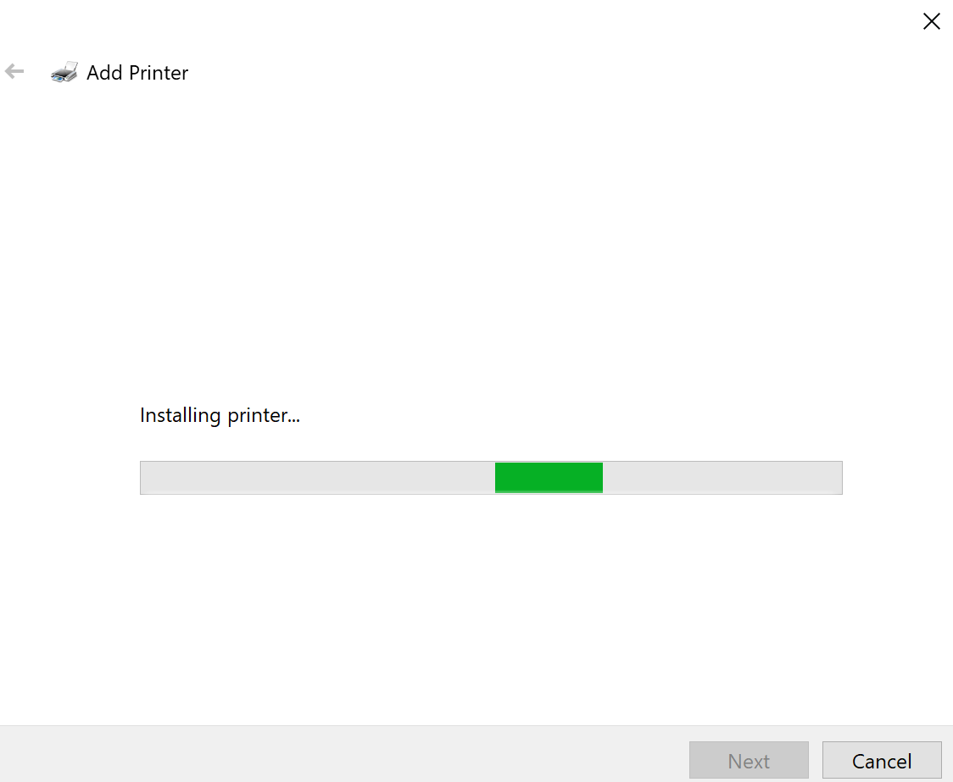
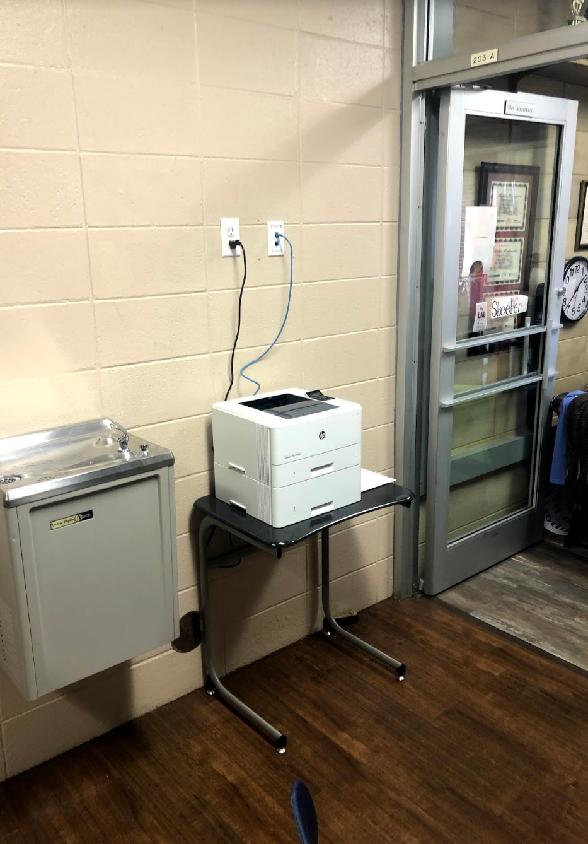
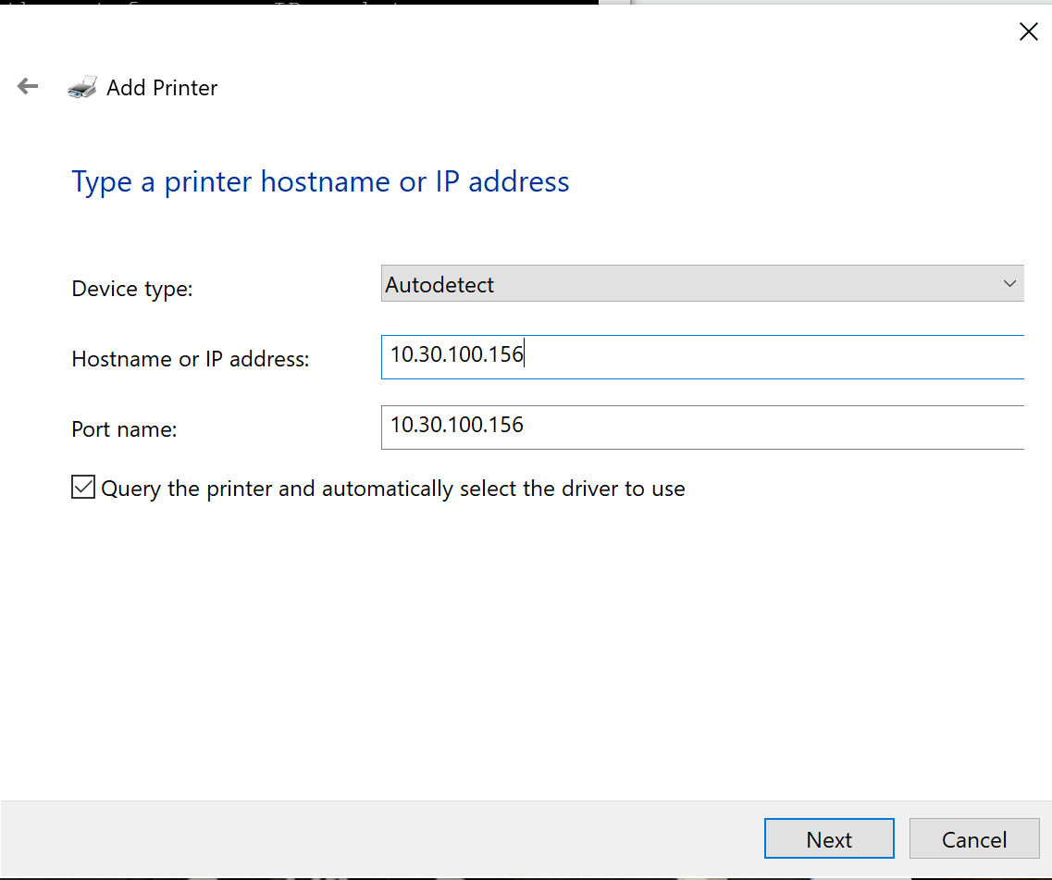
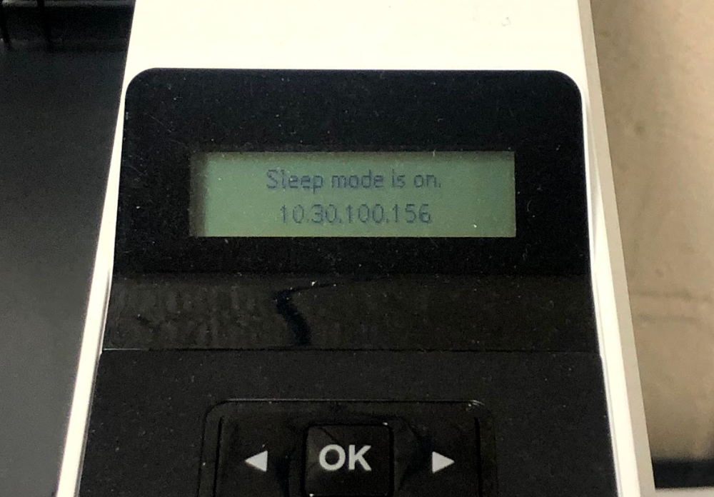
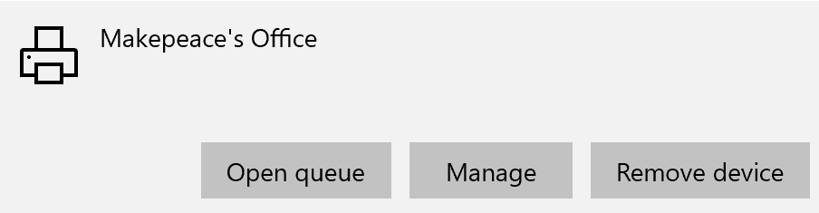
Some day in 2018
Notes:
...so I wondered, are there more printers that I can connect to. I did a little research, and decided to do an IP scan, which is discovering all the devices under the same network that are open to discovery.

Slide 8
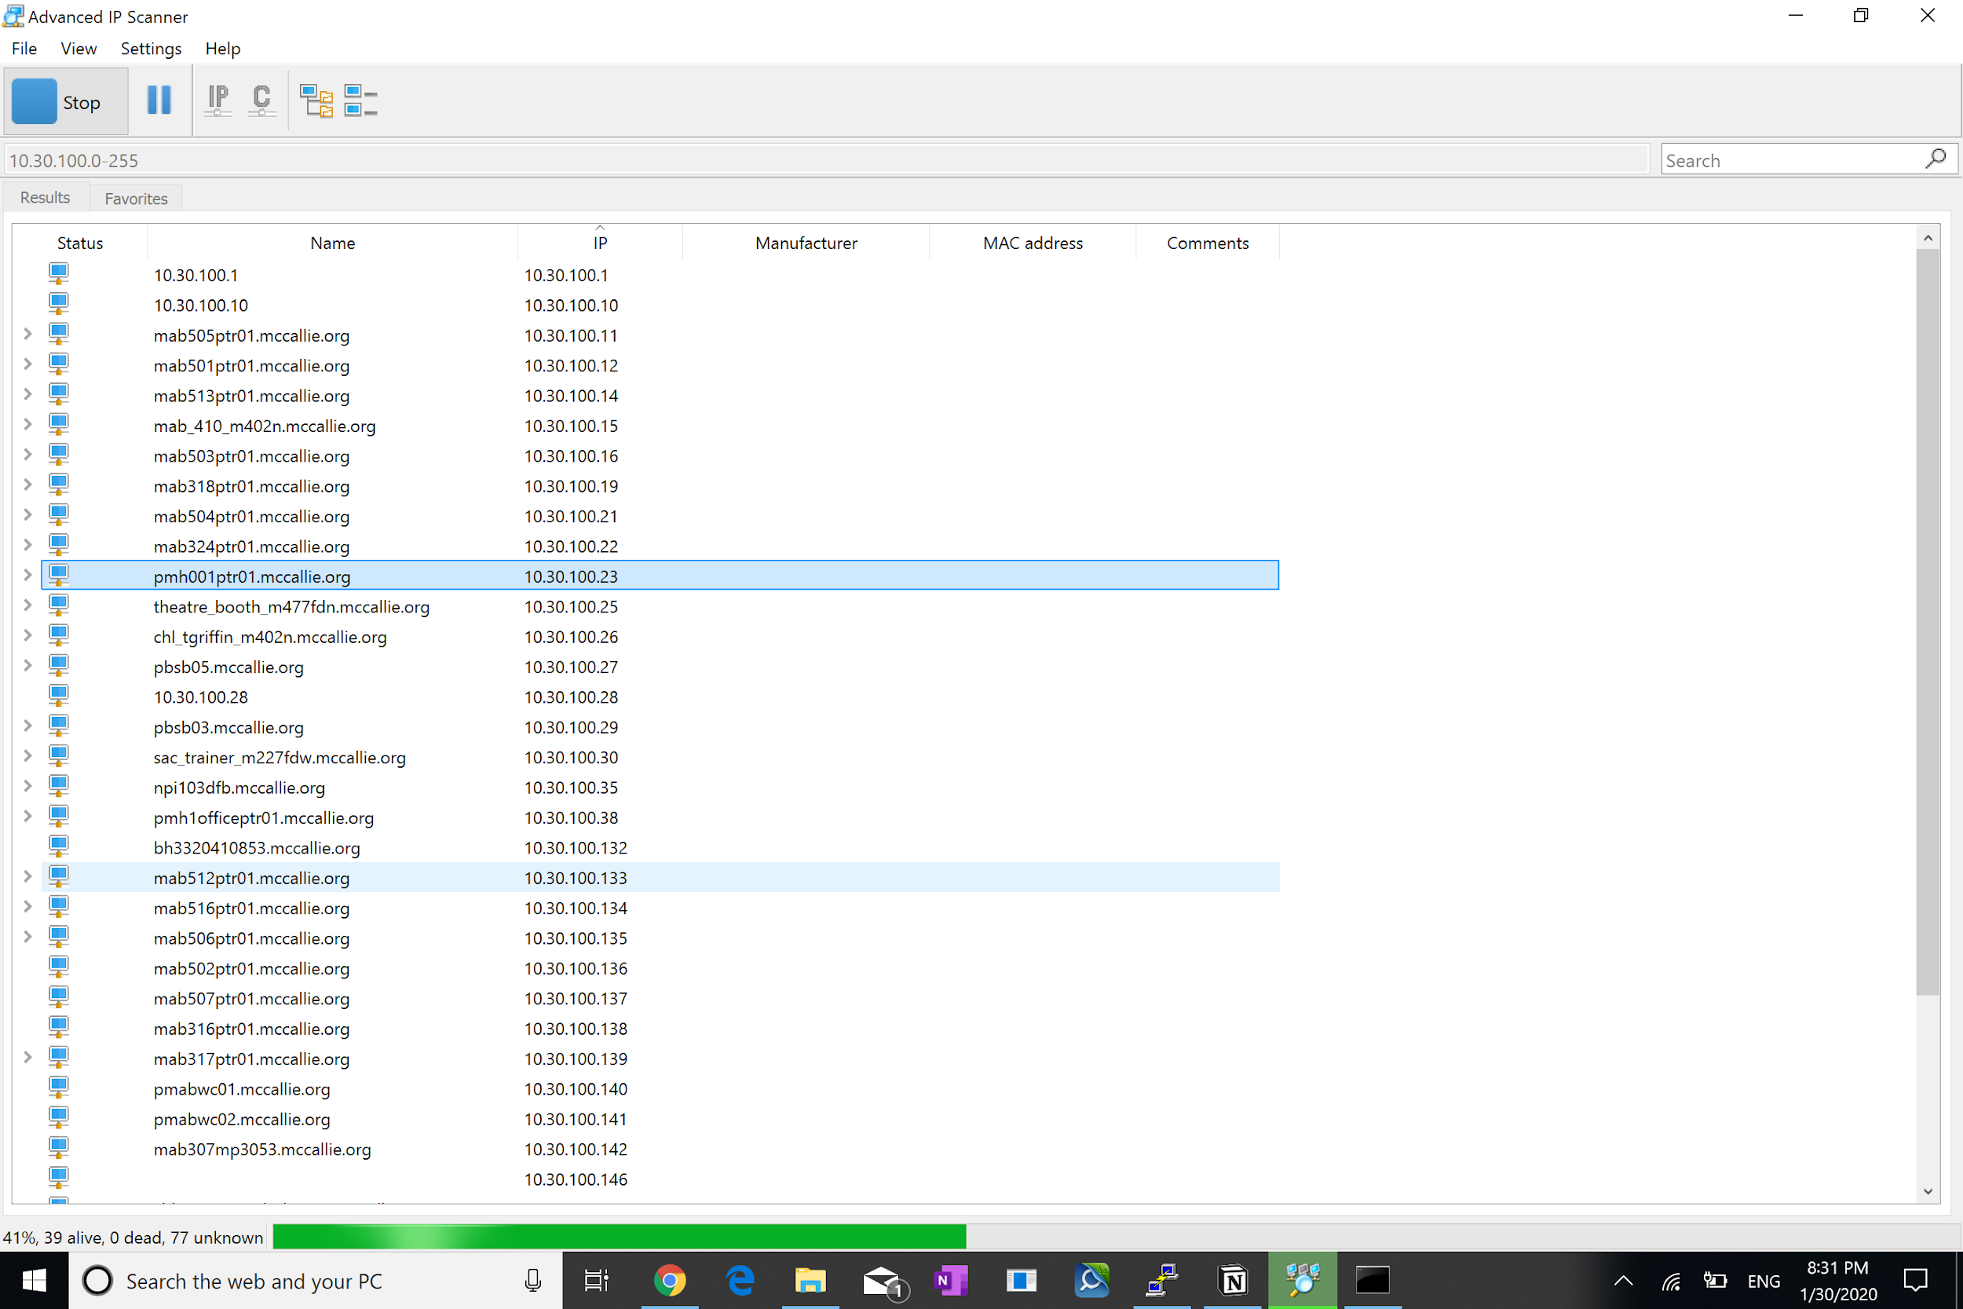
Can there be more such printers?
IP scan!

Slide 9
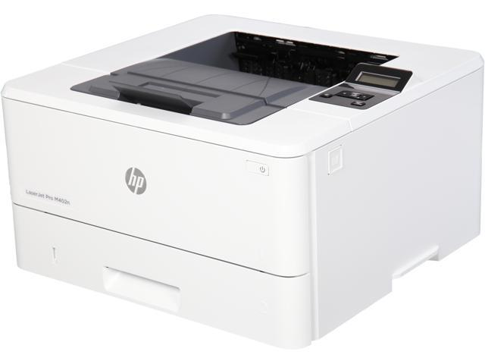
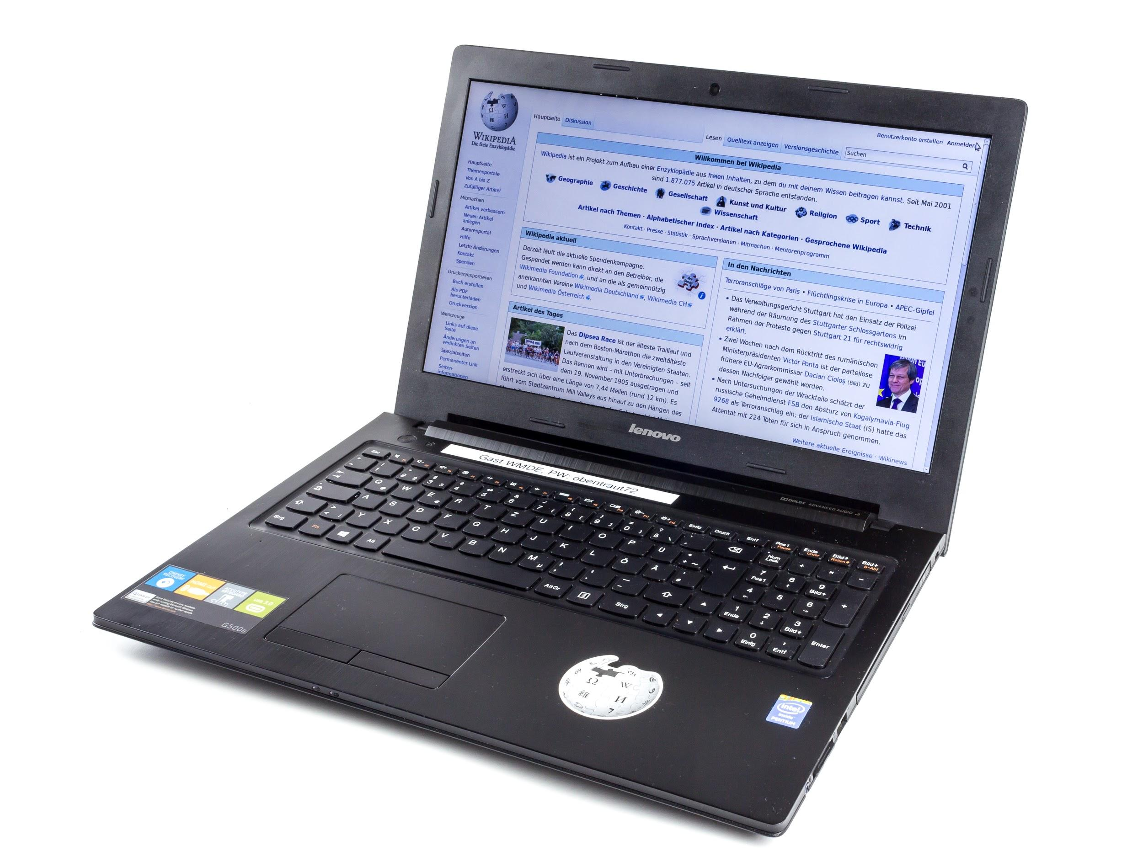
Structure of McCallie’s LAN
Printer group 1
Printer group 2
Invisible barrier
Index information not given
Student devices
Employee devices

Slide 10
Structure of McCallie’s LAN
Printer group 1
Printer group 2
Student devices
Employee devices

Slide 11
Structure of McCallie’s network
Printer group 1 (open to students, not indexed)
Printer group 2 (not open to students)
Writing center printers
Classroom printers (in both MAB and Walker Hall)
Learning center printers
Colored printers
Dorm printers

Slide 12
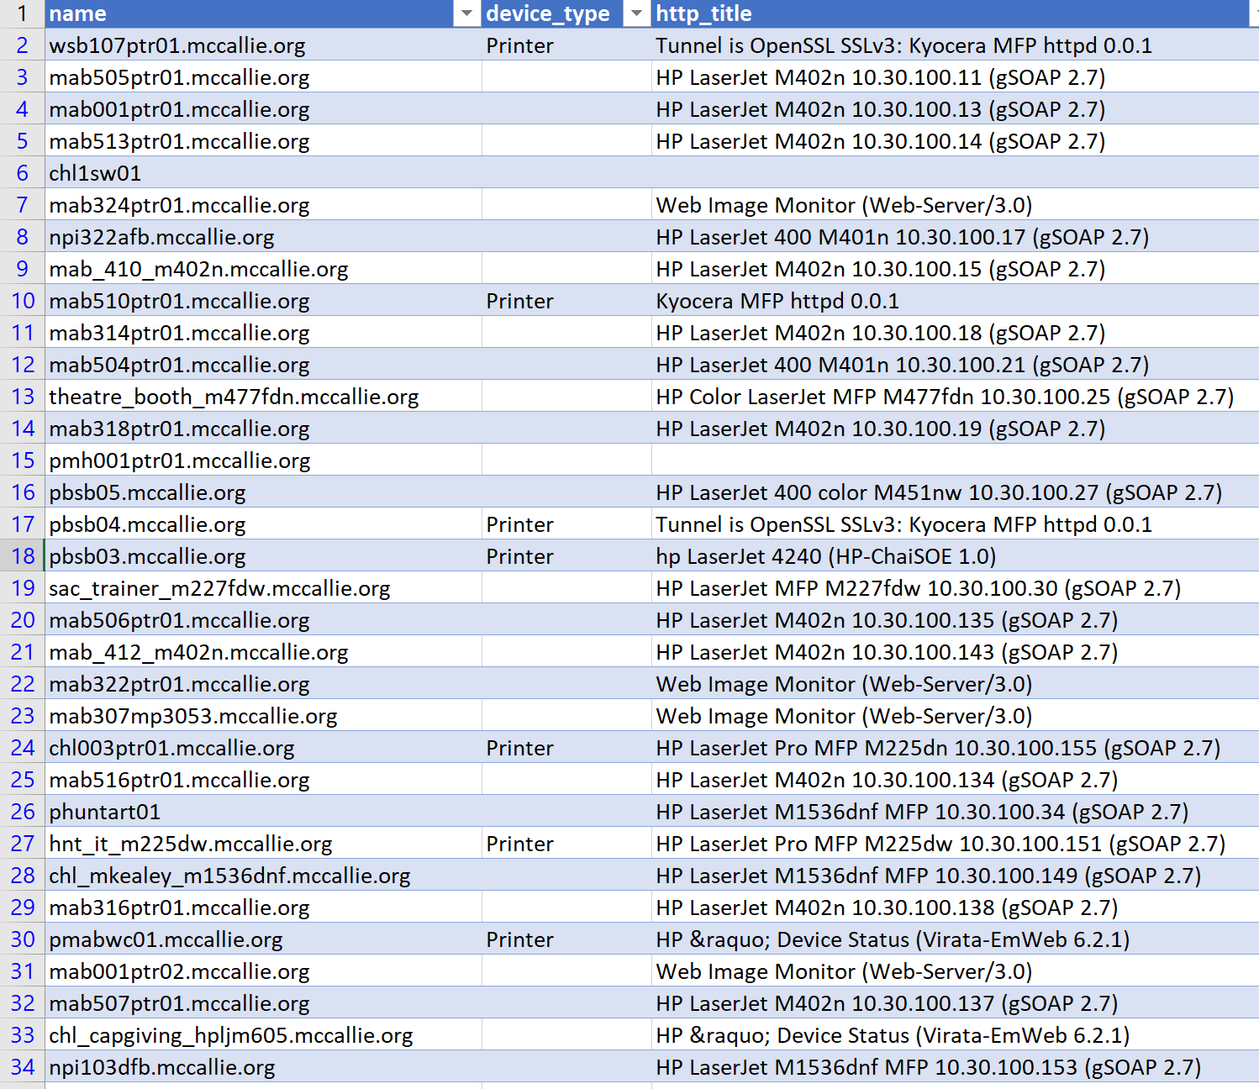
Indexing the printers myself through IP scans
Group 1 printers (more than 40), such as:
Writing Center (pmabwc01)
Innovation lab (wsb107ptr01)
Jones’ classroom (mab314ptr01)
Colored printer in Walker (wsb_107_m451nw)
Notes:
A student came to bagby asking if he is able to print his colored poster. I told him that there is one in Walker. He was not aware of it

Slide 13
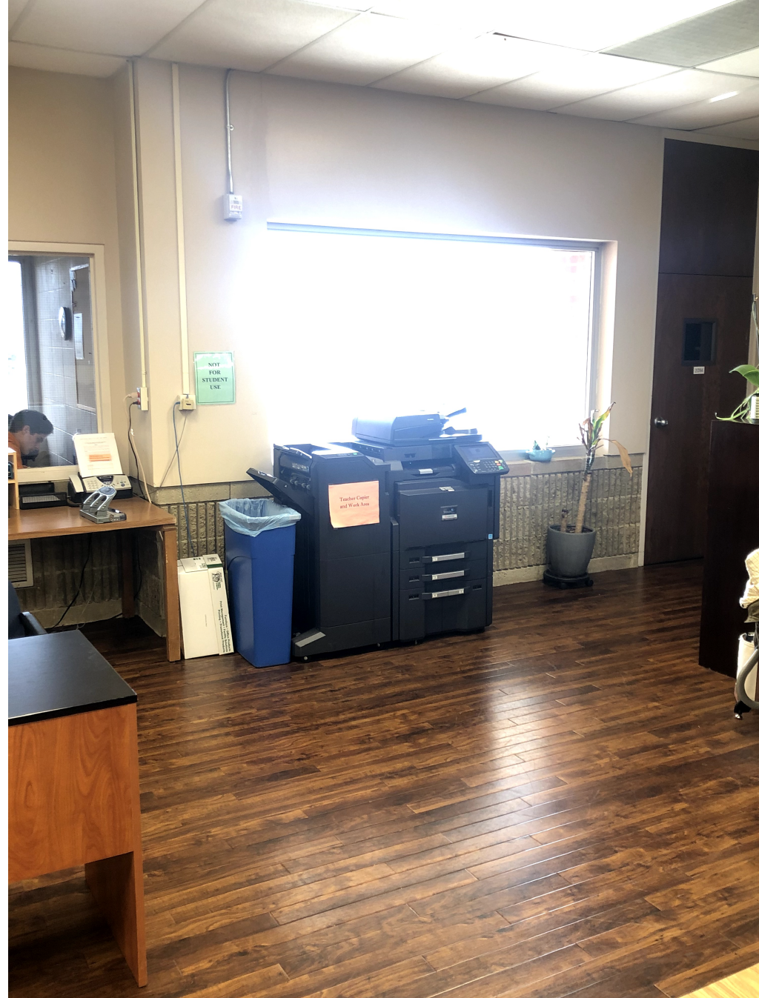
Accessing the group 2 printers
Like this big one in the learning center
Two methods:
Use a school computer (e.g. learning center computer)
Set up proxy through a employee device (or a Raspberry Pi in the innovation lab)
Notes:
I printed off 60 pages of practice test for a student who graduated last year. This print job took less than a third of the time it would have taken on a learning center HP printer. It was also printed two-sided, so it also saved a lot of unnecessary papers.

Slide 14
What are the benefits of directly printing?
FASTER!
MORE RELIABLE!
TRACEABLE!

Slide 15

After these findings,
I talked to
Mr.Robert Wilson,
IT department head

Slide 16
FAQ with issues that Mr. Wilson raised
Will students print excessively?
No. Students with their own laptops are probably self-disciplined enough to know what they want to print. Making it difficult for them to print will result in frustration in grade and potential discouragement from learning more.
Will students accidentally print to the wrong printers (because of typing to the wrong IP address)?
If the printers are properly indexed, and adding a printer is just a copy paste job, Students can print to the wrong printers. The printers can only be connected under McCallie’s network, so day students can’t accidentally print at home. Additionally, students are able to track their print progress and confident that it will print, less paper and ink will be wasted as a result.
Notes:
In fact, I accidentally printed out some Bible material at Shumate’s classroom,
Also Mr.Wilson said that this issue that

Slide 17
Detailed suggestion:
Index all the printers
Inform students how to add printers
Remove the “invisible barrier”

Slide 18
Or simply:
Set up a print server for students

Slide 19
And bonus!
Notes:
I was going to show you guys an extremely amateurish blog site i dug out that the IT people apparently set up as a test and only posted one entry called “this is a test blog,” as a reminder that no one is perfect. It turns out that they took it down after words got out. So I am going to show you something else.

Slide 20
